Slide 1
Application Production Support
February 2023

Slide 2
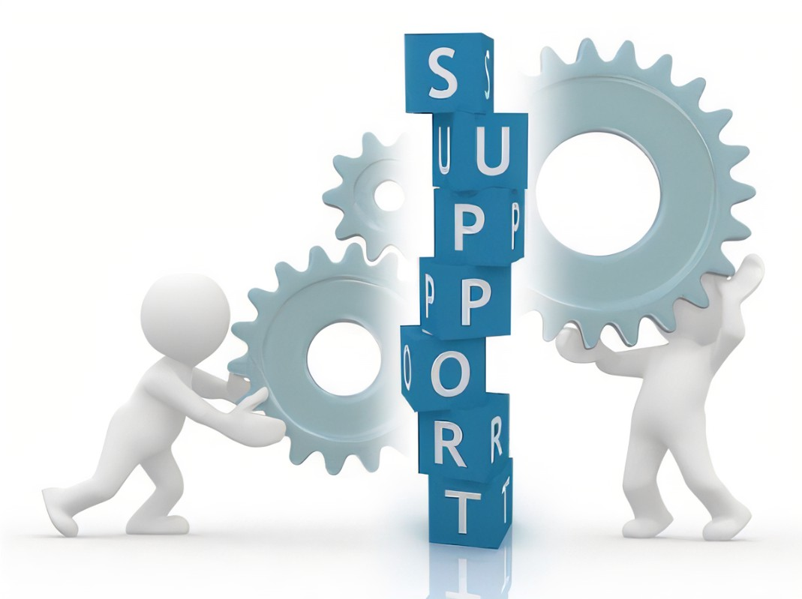
Points of Discussion
What is APS?
APS Team’s roles and responsibilities
Initiating a New application onboarding
Onboarding Checklist
Application maintenance
Engaging APS Team
Initiating an existing application onboarding

Slide 3
What is APS? ( Application Production Support)
Application Production Support
24*7 Service Desk
for Incident/SR creation
Proactive Monitoring of Application System and Alerts
Automation
and Dashboard Creation
Incident and Service Request Resolution
Overview
Application Production Support team is responsible to provide functional and technical support for all MIS applications.
Users can reach out to us via Service Desk as they play the anchorage role between User and APS Team:
Calling Service Desk (Phone: 1-212-553-4357 Select Option #2).
Emailing Service Desk RatingsApplicationServiceDesk@moodys.com
ServiceNow Self Service Portal IT ServiceNow
Availability – 24*7

Slide 4
Definitions
L0:
Attend user calls. Provide monitoring and “real-time” (eyes on glass) services to gauge the health and wellness of the environment/application.
Monitor the incoming alerts, create incidents escalate to right team and provide ready for business check
L1 :
Provide first level investigation of the alerts and Incidents.
L1 will also execute the simple and medium service requests. L1 team will analyze the alerts..
L2:
SME’s with knowledge of the application and technology ,responsible for resolving the critical and complex application issues via Incident management.
L2 will drive the problem management and coordinate with dev and Infra teams for root cause analysis.

Slide 5
Roles and Responsibilities of APS Team
L1:
Incident Management
Resolve incidents and requests with help of KB/SOP
Acknowledge and resolve Incidents
Periodically review and minimize MTTR
Prioritize the Incidents based upon the severity
Escalate and include L2/dev in case unable to resolve issues
Knowledge on Splunk, AppDynamics
Log analysis on Splunk
Basic Triaging on AppDynamics
Identify opportunities to build Splunk dashboards
Email alerts monitor and handling
Daily review of ServiceNow/Tableau dashboards
Regular connect and scrum call with respective function lead for open KB/SOPs issues/doubts
Weekend Sanity Support – Adhoc and scheduled
L2:
SME level knowledge of Business Applications
Have the architecture level Knowledge
Handy dev contacts and servers/DB level details
Handy Batch jobs details
Have knowledge of logs analysis of Unix, Linux and windows servers
Periodic review of Infra, ControlM, DB, AppDynamics and Splunk alerts
Have knowledge to debug and to carry out RCA
Triage critical business outages with help of various stake holders and communicate with dev, Infra and Senior Management
Develop SOPs or KB for recurring incidents or SRs
Problem management
Incident Management (extension of L1 support)
Sync with Change and Infra team for weekend changes and prioritize sanity and impact
Regular review of ServiceNow/Tableau dashboards

Slide 6
APS Team - Additional Activities
Application Production Support
Incident and Service Request Resolution
Monitoring
Splunk and AppDynamics dashboard creation
Dashboarding
False Alert Rationalization
New App On-boarding
Runbook Walkthrough
Documentation and Operations
KB Article creation
24*7 RASD support
Automation Opportunities
Enabling Synthetic Monitoring
Problem Ticket Management
MTTR Analysis
Capacity Management Analysis
Confluence Page creation
SPOC Identification
Email Alerts suppression
Business Req dashboards
Tableau dashboards
Automation
Testing capability of monitoring
Stages of App-On-boarding

Slide 7
Engaging Application Production Support Team
When to engage Production Support team
For logging/reporting open issue that the user is facing in the MIS Tech applications
Via Calling RASD (Service Desk) (Phone: 1-212-553-4357 Select Option #2).
Emailing Service Desk RatingsApplicationServiceDesk@moodys.com
ServiceNow Self Service Portal IT ServiceNow
Any Outage scenario or in case of Business disruption
Changes in the existing application as part ongoing maintenance
Application Tech Stack migration to new platform
Launch of new application replacing the old one
New Application Onboarding

Slide 8
Existing Application Onboarding - Process
Production support team can be engaged to provide end user support for any existing business application, which is already available in production.
In order to ensure a smooth transition, support team should be provided all the below details:
Business purpose and usage
Application Architecture, data flow, technical design etc
Application performance benchmarks based on functional and regression testing
Appropriate knowledge transfer sessions should be conducted during each items listed above.
The APS team follows the Runbook and NAO checklist to get the details from the team. Below are the high-level activities
Kick-off discussion with the team getting on-boarded
KT planning and identification of SPOC’s
Creation of new DL’s if needed and enabling RASD
Access to environment (preferably both Low level and High level)
KT and Reverse KT completion. Provide Shadow support and start ticket resolution
Creation of Confluence page for APS team
Business and Dev Teams signoff

Slide 9
New Application Onboarding - Process
Production support team can be engaged to provide end user support for any new business application, prior to it being released in production.
In order to ensure a smooth transition, support team should be engaged during below stages of the application development:
Once the functional requirements are finalized (to understand business purpose and usage)
Design phase completed (to understand the proposed architecture, data flow, technical design etc.)
Functional and Regression testing completed (to understand the application performance benchmarks)
Prior to deployment (as a last check to confirm the support team’s readiness and other items identified in checklist)
Appropriate knowledge transfer sessions should be conducted during each phase listed above.
The APS team follows the Runbook and NAO checklist to get the details from the new team. Below are the high-level activities
Kick-off discussion with the team getting on-boarded
KT planning and identification of SPOC’s
Creation of new DL’s if needed and enabling RASD
Access to environment (preferably both Low level and High level)
KT and Reverse KT completion. Provide Shadow support and start ticket resolution
Creation of Confluence page for APS team
Business and Dev Teams signoff

Slide 10
New Application Onboarding/Checklist
Production Support team requires below information to plan for resources and technical expertise required for effective support:
Application Name
Number of users / Users’ LOB
Monitoring capability
DR capability
Geographical location of the users
Required support coverage hours
Anticipated ticket volume (per week / per month)
Business owner / Product owner
Escalation point of contacts in development / BA teams
Technology Stack
Production Support team will ensure all items in below checklist have been completed:
Service-to-Service relationship should be updated in SNOW CMDB
Runbooks / Playbooks for specific application procedures like steps to restart application etc.
SNOW Assignment groups (L1, L2, and L3) and incident/request workflows should be created
Application health monitoring should be set up in AppDynamics/Splunk ATC Dashboards with appropriate notification mechanism
Knowledge Transfer Sessions should be conducted among Product Management/Development team and Production Support
Any system documentation (functional requirements, technical/data flows, jobs etc.) should be provided to support team to aid incident investigation
Details of system account names, owners & usage (week prior to go live)
Test cases for application availability check

Slide 11
Changes in existing applications
If any maintenance or enhancement changes are done to an existing application currently supported by production support team, below activities are to take place for continued support:
Knowledge transfer sessions should be conducted on the relevant topic.
Application documentation should be update to incorporate the changes.
Confluence page should be updated as applicable
Monitoring Alerts should be updated wherever applicable

Slide 12
Thank You

